Slide 1
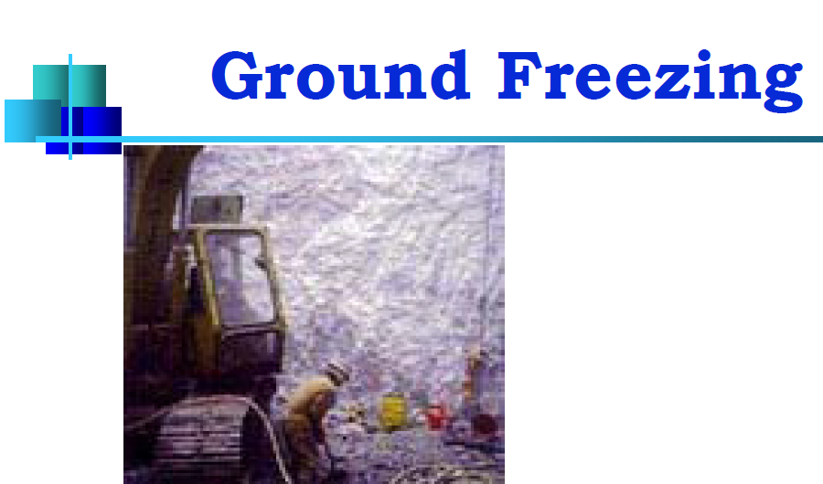

Slide 2
Ground freezing is a process of making water-bearing strata temporarily impermeable and to increase their compressive and shear strength by transforming water into ice.
Freezing is normally used to provide structural underpinning; temporary supports for an excavation or to prevent ground water flow into an excavated area.
It is applicable to a wide range of soils but it takes considerable time to establish a substantial ice wall and the freeze must be maintained by continued refrigeration as long as required.

Slide 3
Ground freezing may be used in any soil or rock formation regardless of structure, grain size or permeability, however, it is best suited for soft ground rather than rock conditions.
As the impervious frozen earth barrier is constructed prior to excavation, it generally eliminates the need for dewatering, or the concern for ground collapse during dewatering or excavation.

Slide 4
Principles of Freezing
The effectiveness of freezing depends on the presence of water to create ice, cementing the particles and increasing the strength of the ground to the equivalent of soft or medium rock. If the ground is saturated or nearly so it will be rendered impermeable if there is not enough moisture it may be necessary to add water.
The strength achieved depends on freeze temperature, moisture content and the nature of the soil.
On freezing, water expands in volume by about 9% which does not itself impose any serious stresses and strains on the soil unless the water is confined within a restricted volume. With water content up to about 30% the direct soil expansion may be about 3%.

Slide 5
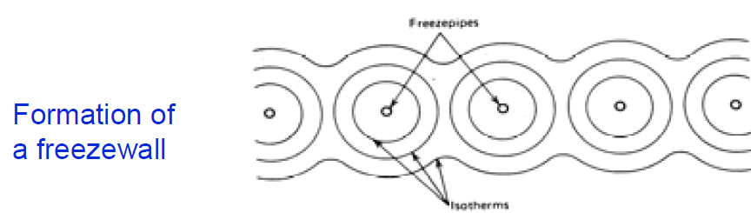
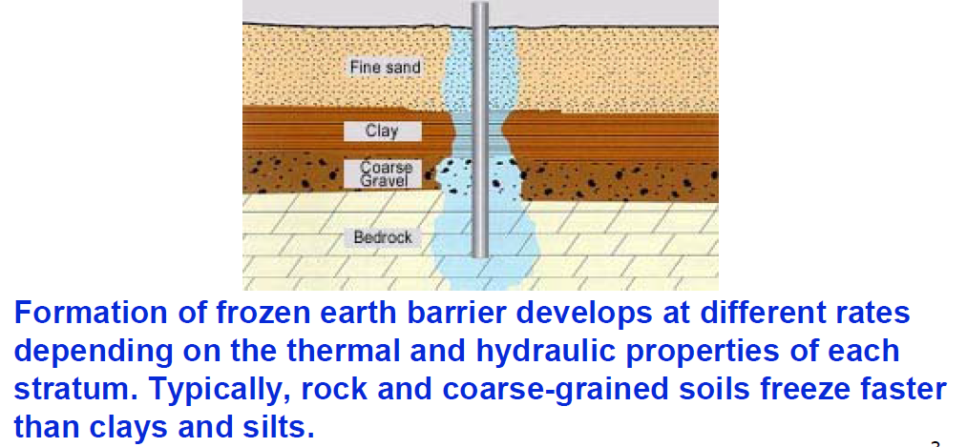

Slide 6
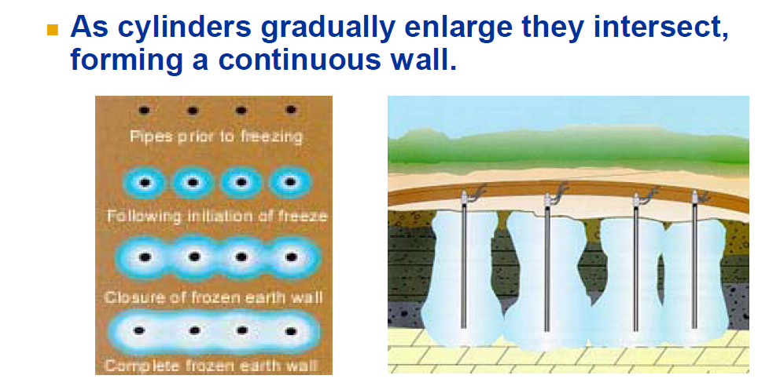

Slide 7
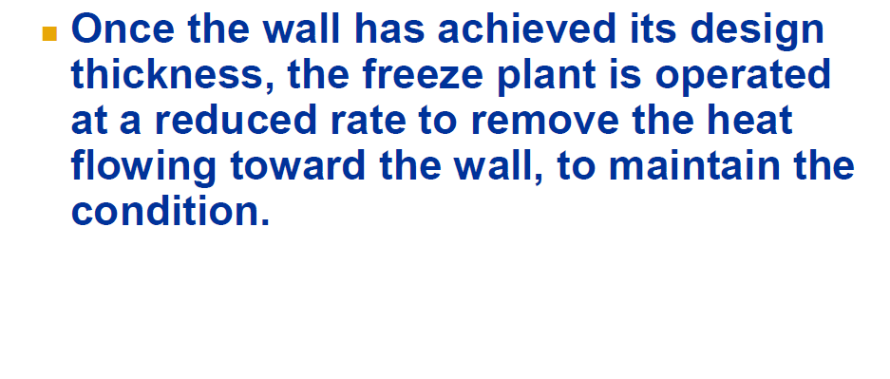

Slide 8
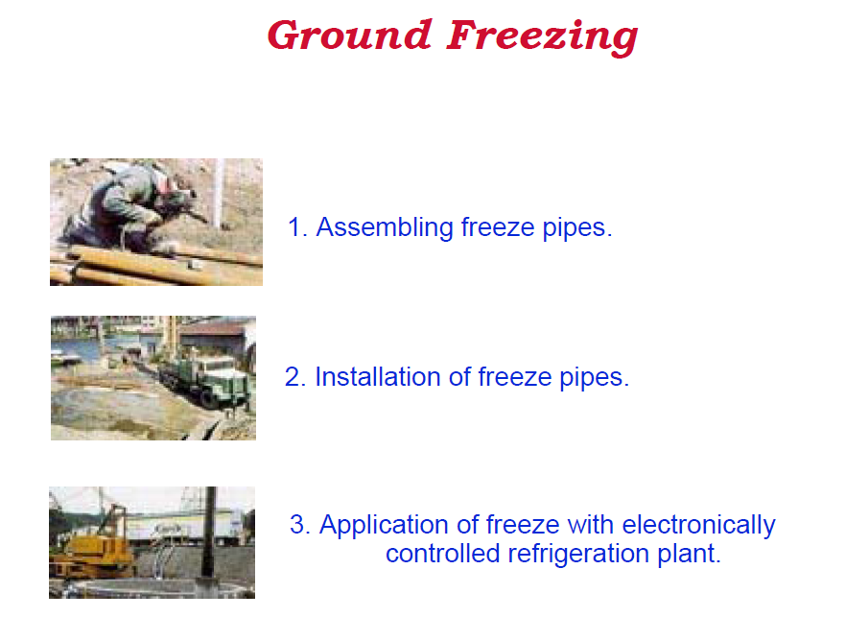

Slide 9
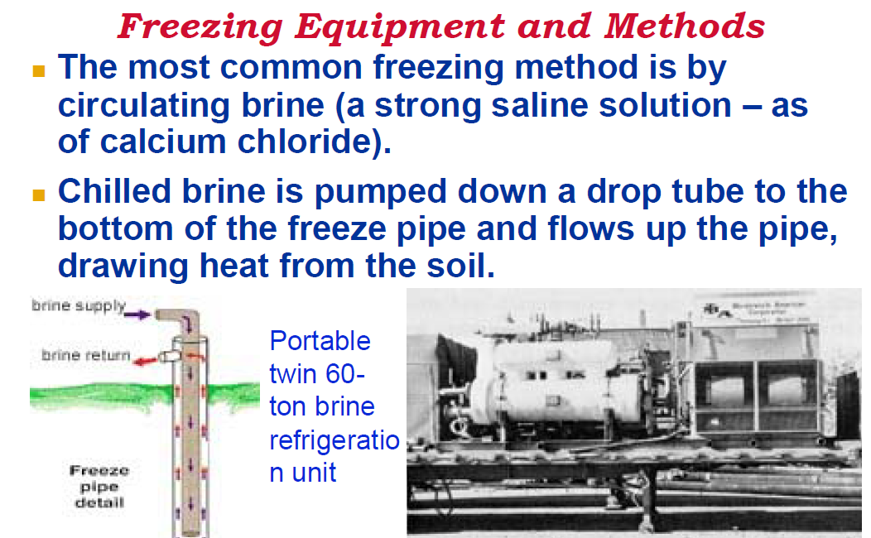

Slide 10
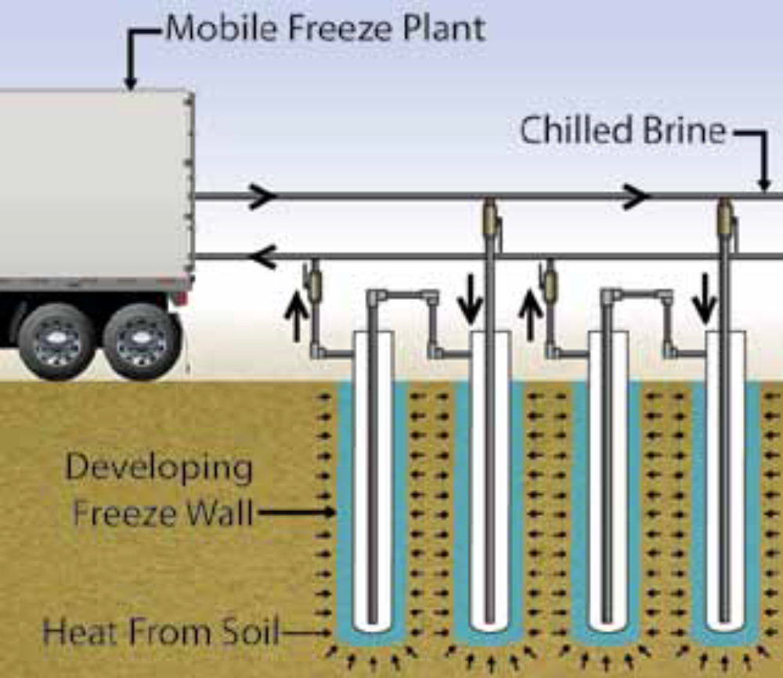
Freezing Equipment and Methods

Slide 11
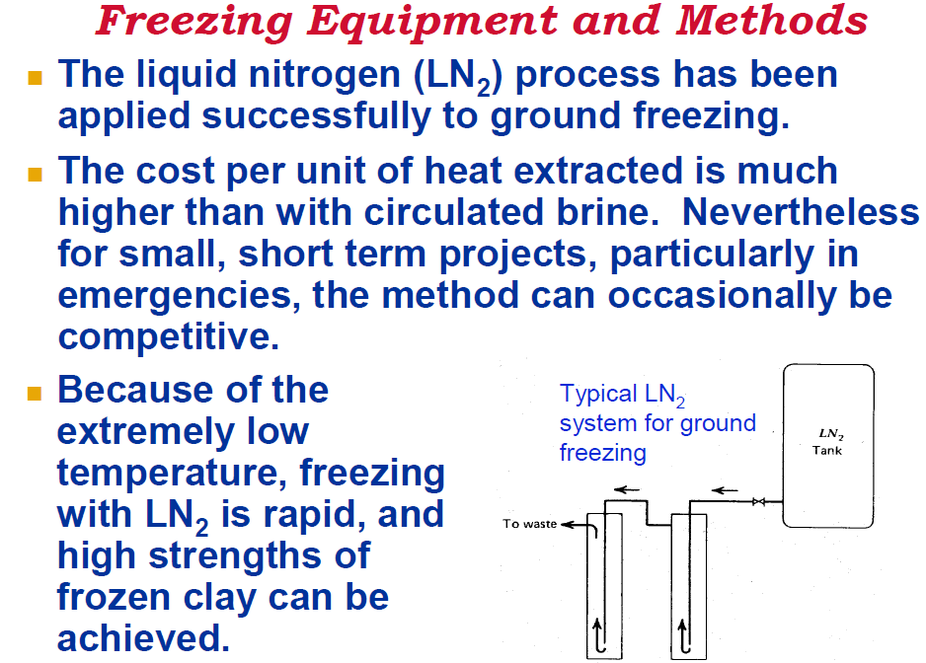

Slide 12
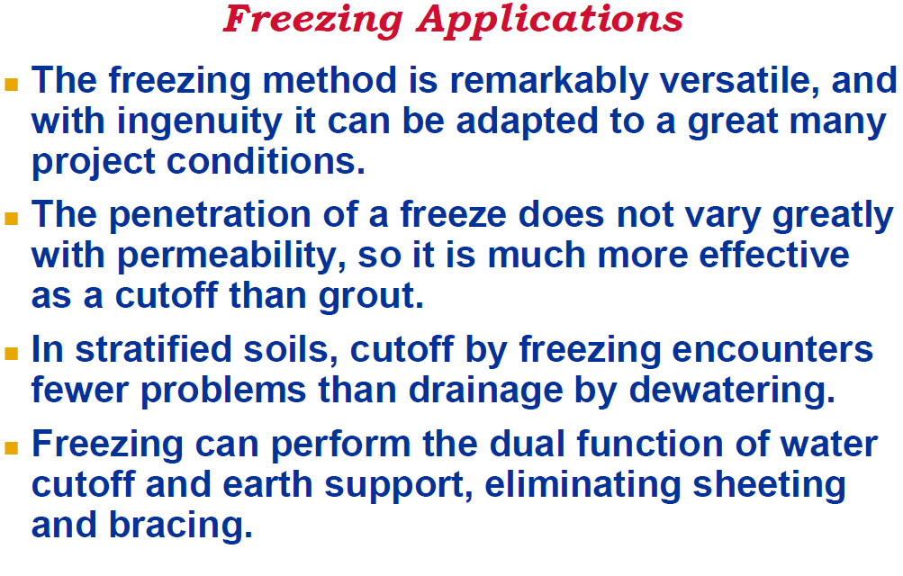

Slide 13
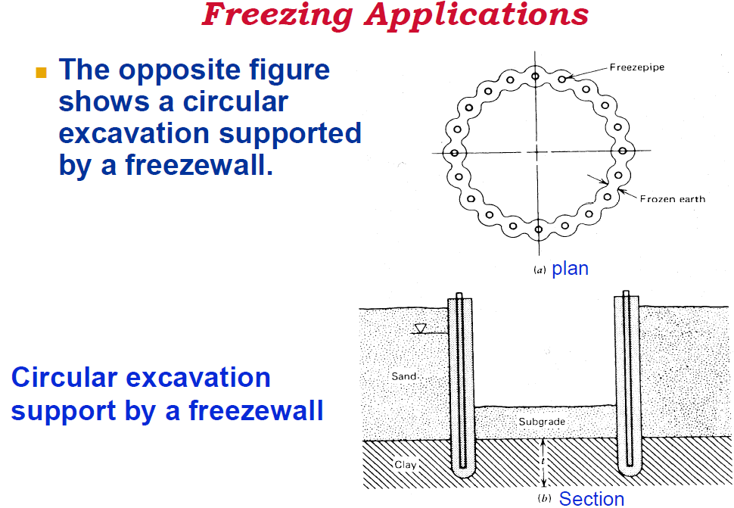

Slide 14
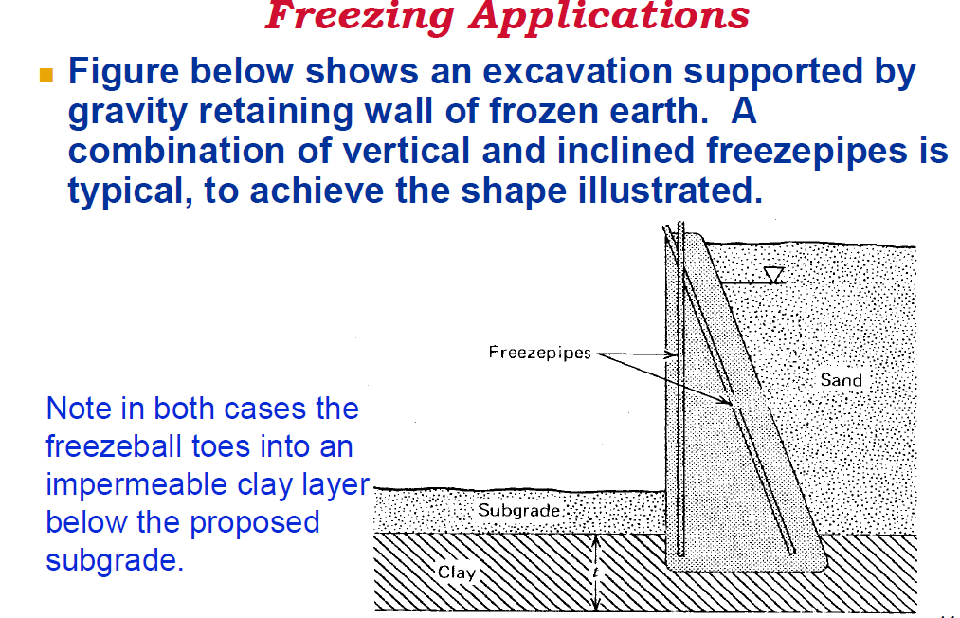

Slide 15
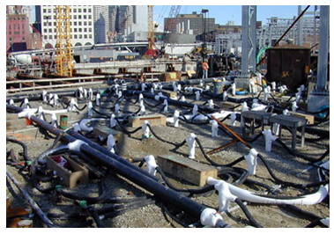
Freezing Application

Slide 16
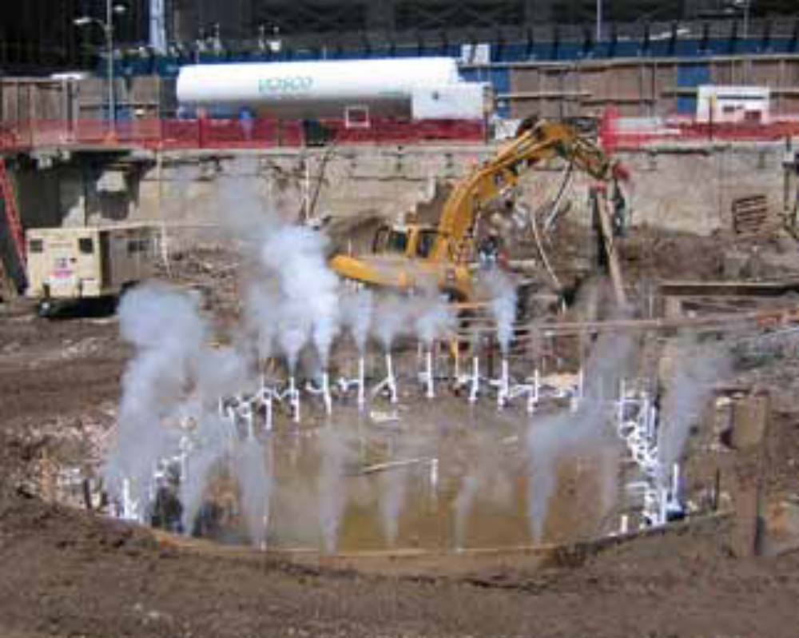
Freezing Application

Slide 17
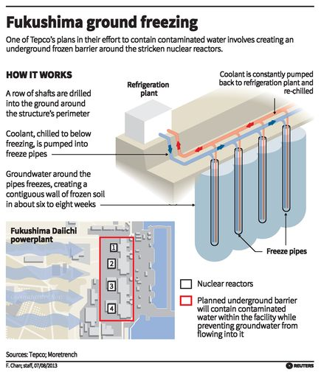
Ground Freezing

